Slide 1


Slide 2


Slide 3


Slide 4


Slide 5


Slide 6


Slide 7
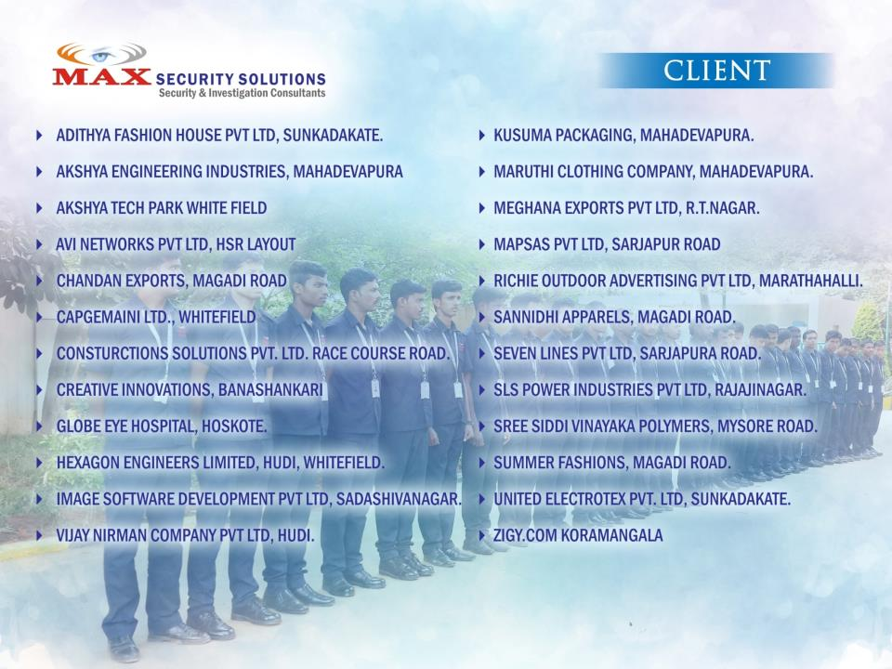

Slide 8
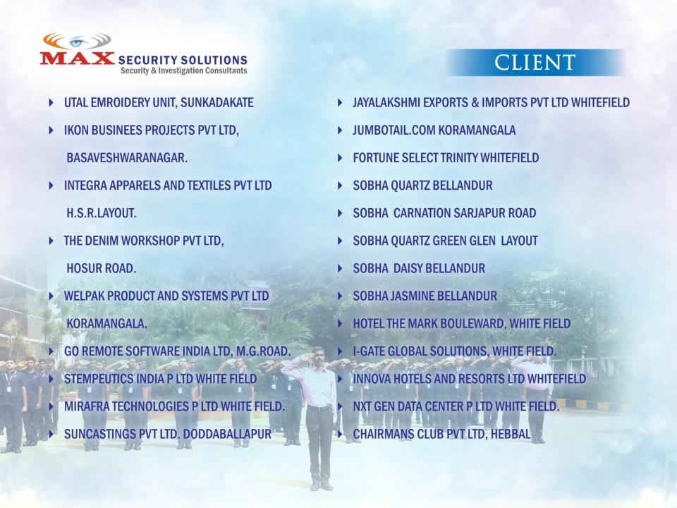

Slide 9


Slide 10


Slide 11

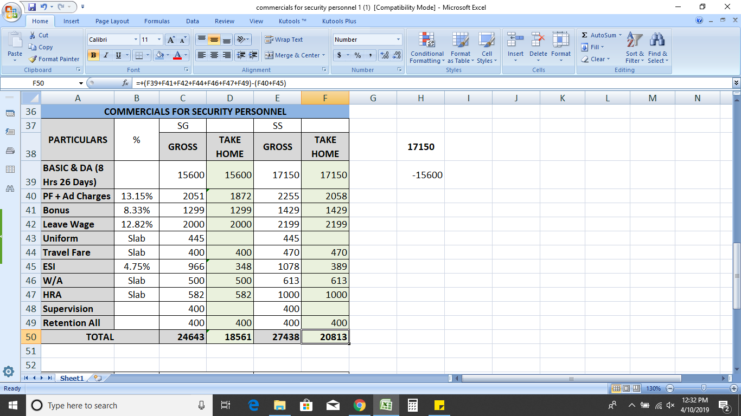

Slide 12
Note:
1 | Service Tax as applicable shall be charged extra. Service tax or any other tax shall be effective as per rates notified by the government.
2 | Any Security Equipment provided shall be charged on actuals
3 | The rates quoted above are based on wages, cost of materials and other expenses. In case of variation in the rate of wage as notified by the Government the unit rates shall be revised to absorb the direct increase in wage and the corresponding social security costs involved.
4 | Deployment shall be assessed based on the survey conducted.
5 | Payment Term in India is 15days.
Thanking You
With Fond regards
Avinash Guruswamy G
CEO -MAX Security Solutions

